Slide 1
PCU UTAH (SSN-801)
CDR Chris Hornung, Commanding Officer

Slide 2
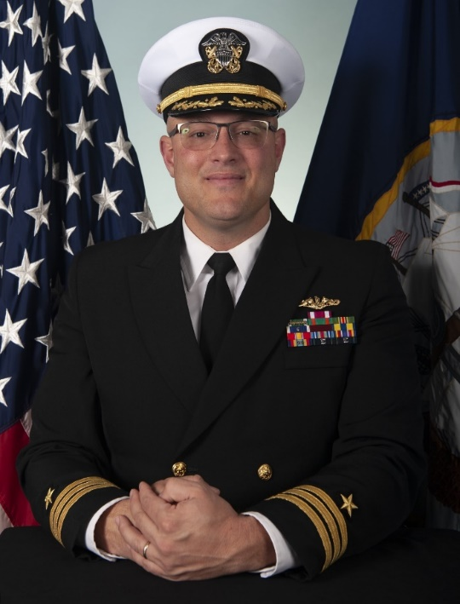
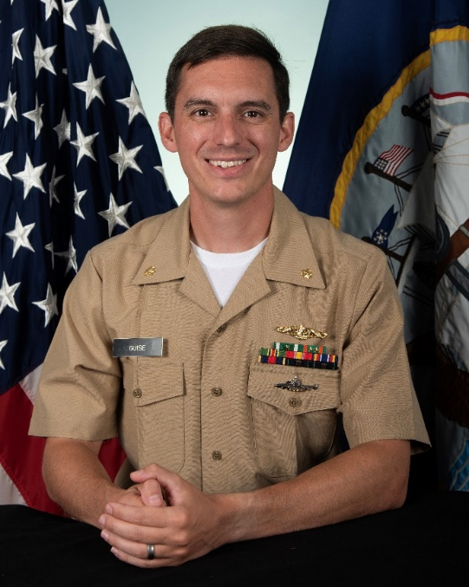
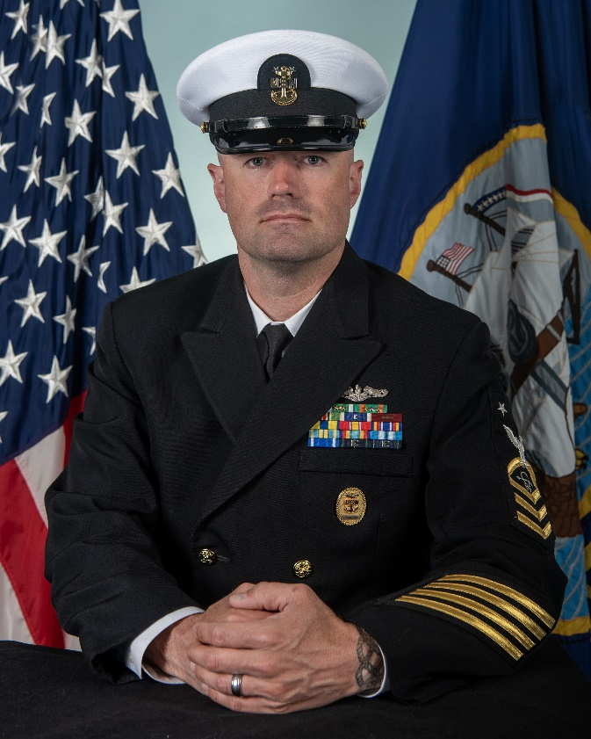
UTAH TRIAD LEADERSHIP
COMMANDING OFFICER
EXECUTIVE OFFICER
CHIEF OF THE BOAT

Slide 3
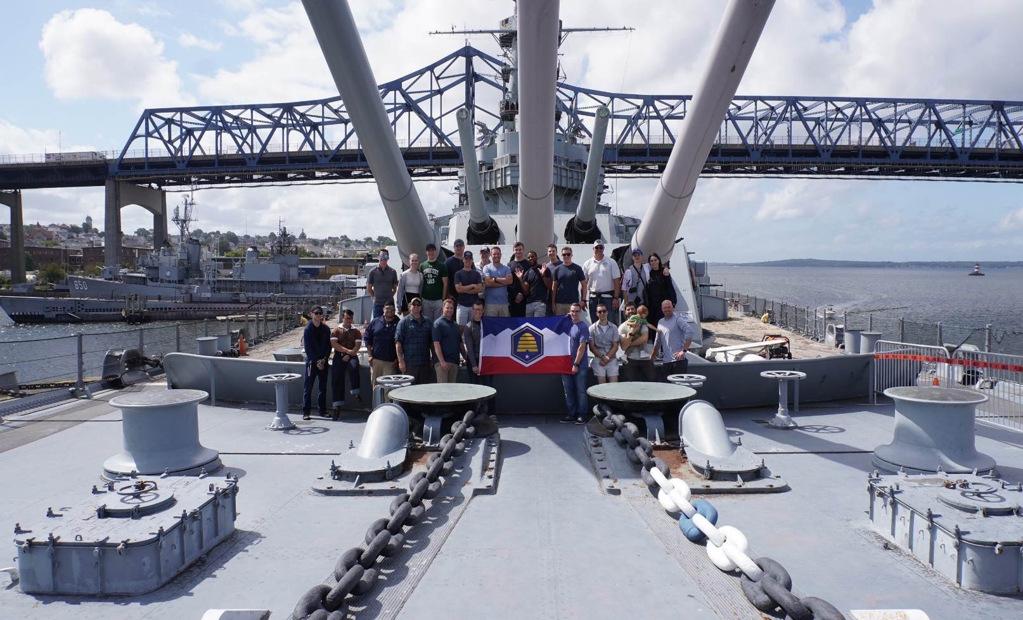
CREW COMPOSITION
Incremental manning based on boat construction schedule
140 total at full manning (122 enlisted and 18 officers)
Women in Submarines
Sea Tour lengths
54 first term Enlisted
32-26 months DH/CPOs
32 month Junior Officer
20-22 month XO
32-34 month CO

Slide 4
UTAH CREST
Crest border
Stars
Motto- Live Strong and Free
Wasatch Mountains
BB-31 silhouette
Font

Slide 5
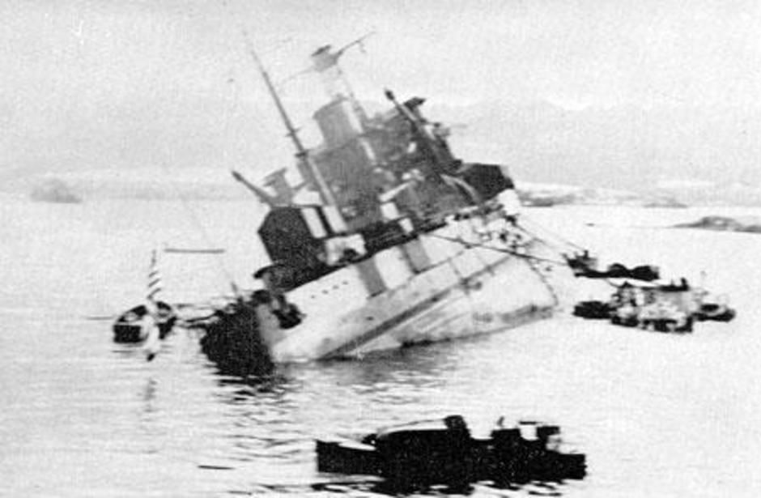
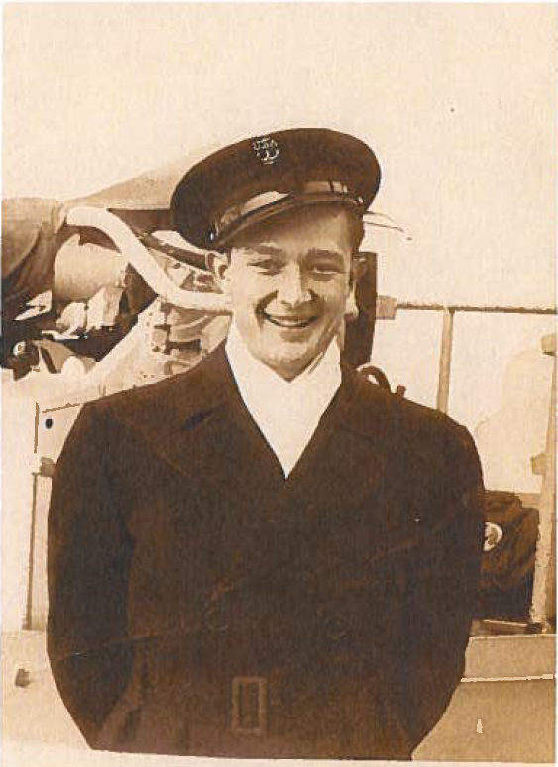
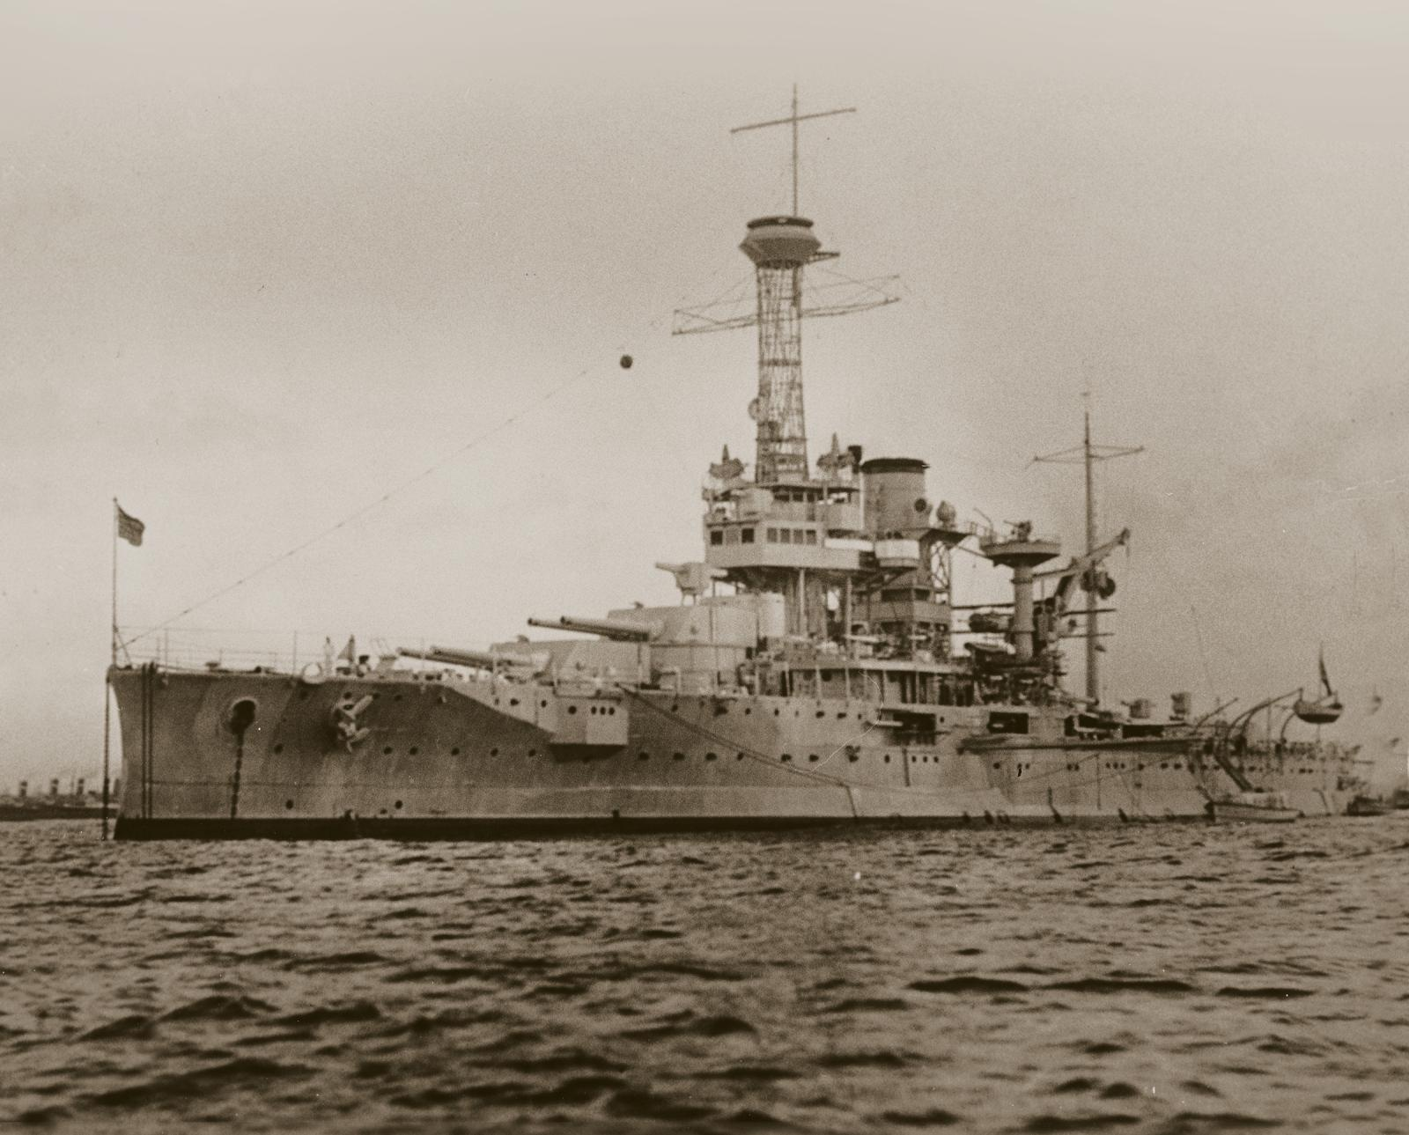
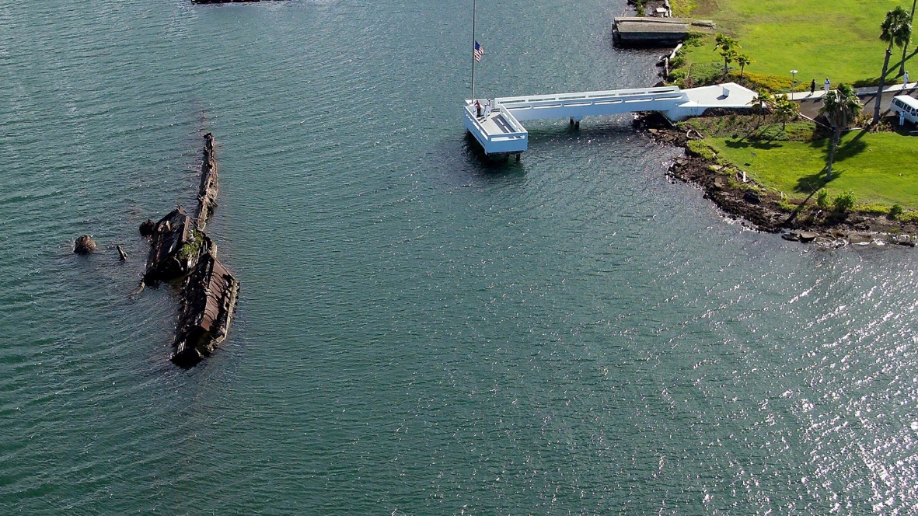
HISTORY OF UTAH SHIPS

Slide 6
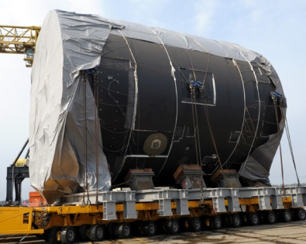
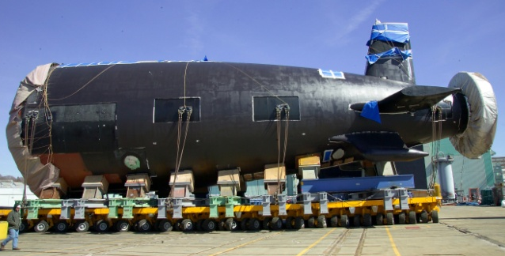
VIRGINIA CLASS CONSTRUCTION
Sections 1 thru 2A
Sections 2B thru 5
Sections 6 and 7
Sections 8 and 9

Slide 7
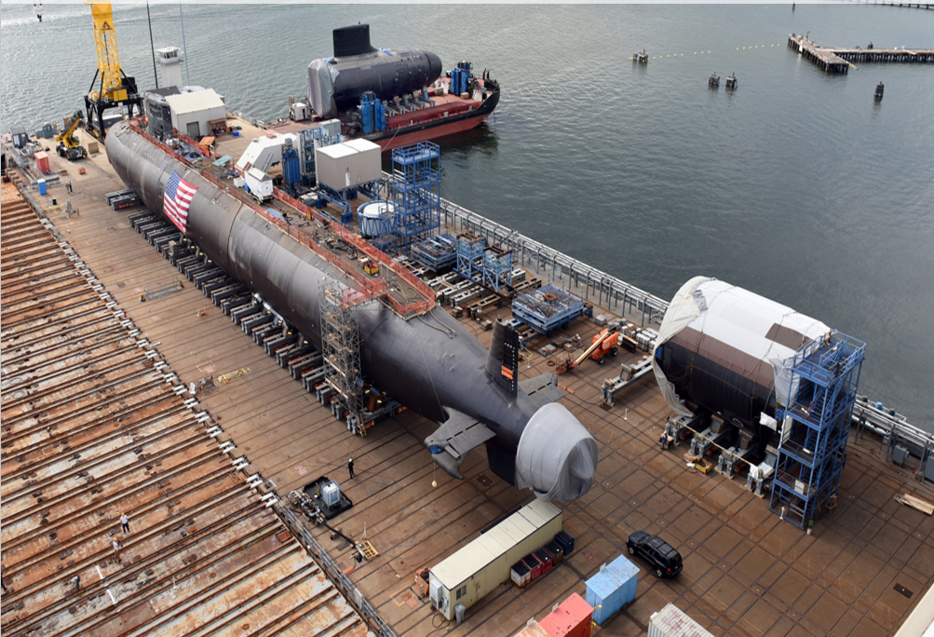
KEY CONSTRUCTION MILESTONES
Pressure Hull Complete
Reactor Plant Testing and Certification
Crew Habitability and In-Service
Ship and Crew Certification for Sea Trials

Slide 8
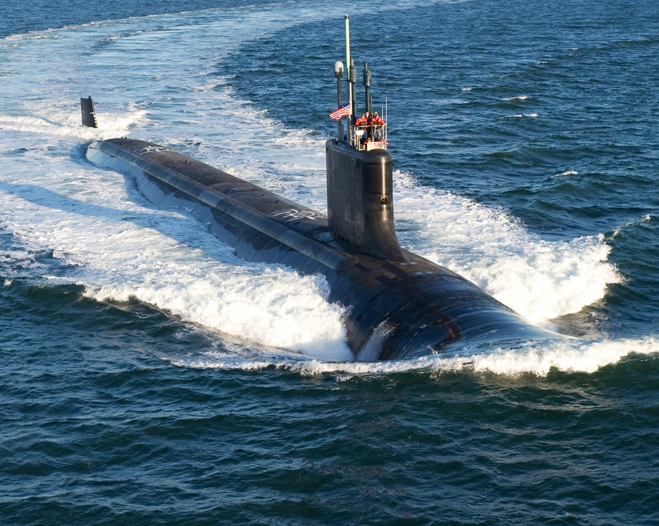
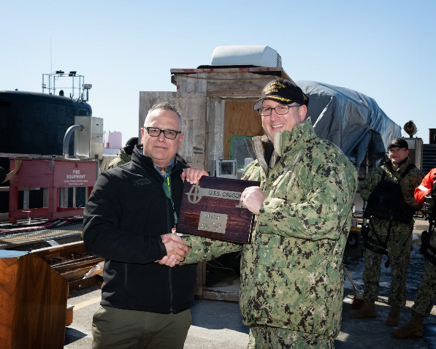
SEA TRIALS AND DELIVERY
Alpha Trials
Bravo Trials
INSURV
Delivery: “Keys to the Ship”

Slide 9
VIRGINIA CLASS ADVANTAGE

Slide 10
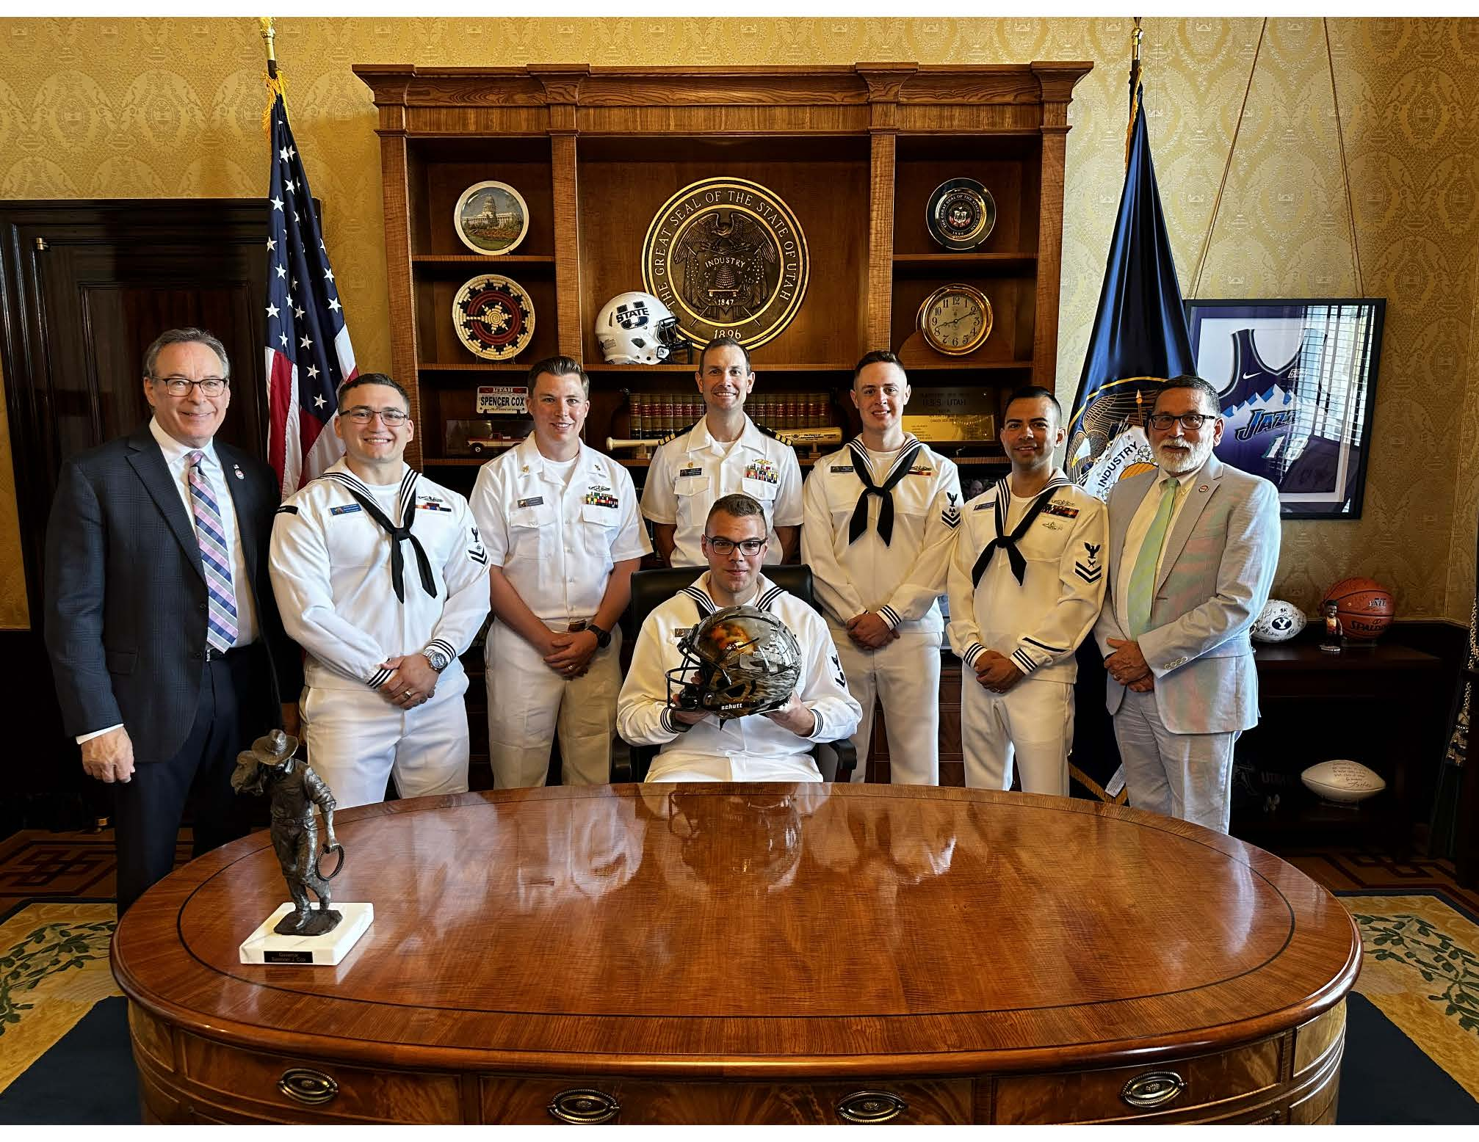
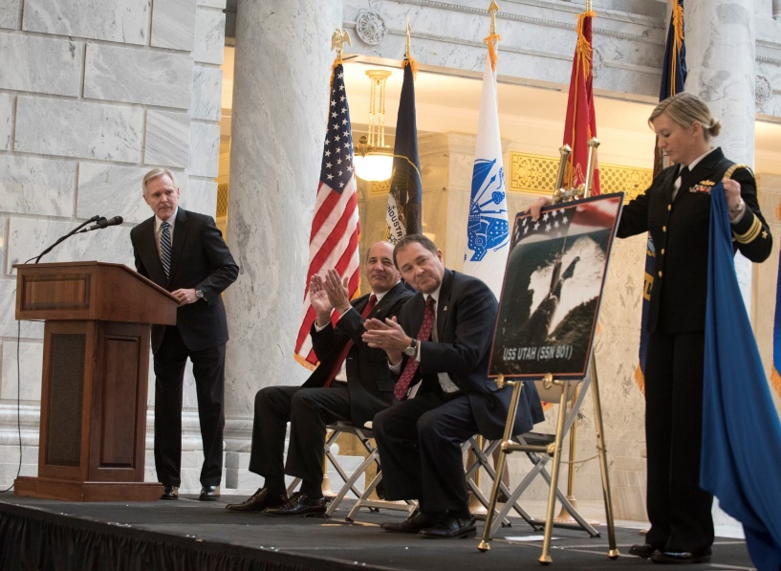
UTAH COMMISSIONING COMMITTEE
Represent the State of Utah throughout boat’s major milestones
Pioneer Day Celebration
Key contributor to morale and team building events

